Slide 1
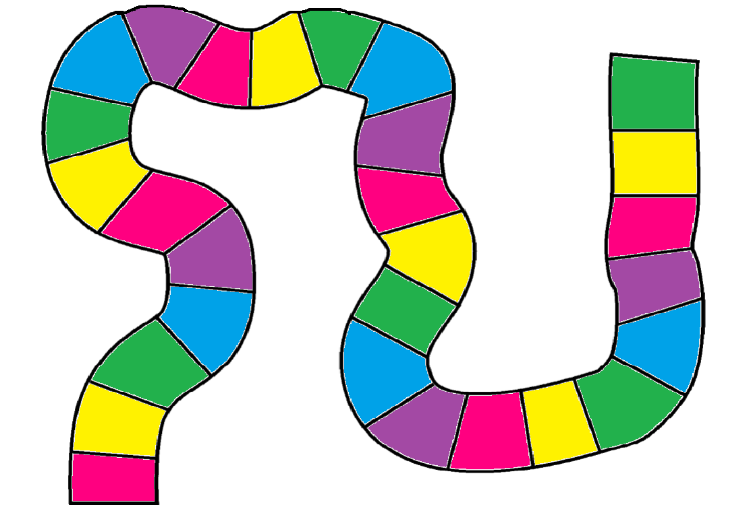
Finish
Start

Slide 2
Identify each of the following as a: noun (proper or common, verb, adverb, or adjective
horse
crash
Canada
hand
Common noun
Verb
Proper noun
Common noun
Back

Slide 3
Conjugate this phrase into the: past tense
I (walk) to the store yesterday.
I walked to the store yesterday.
Back

Slide 4
Conjugate this phrase into the: present tense
He (ride) his bike to school every day.
He rides his bike to school every day.
Back

Slide 5
Conjugate this phrase into the: future tense
We (pick) apples on Friday.
We will be picking apples on Friday.
Back

Slide 6
Identify the correct pronoun
These seats are their seats; they are not our seats.
These seats are theirs; they are not ours.
Back

Slide 7
Identify each of the following as a: noun, verb, adverb, or adjective
baby
Jessica
bake
climb
Common noun
Proper noun
verb
verb
Back

Slide 8
Conjugate this phrase into the: past tense
He (run) when it (start) to rain.
He was running when it started to rain.
Back

Slide 9
Conjugate this phrase into the: present tense
I (eat) my lunch right now.
I am eating my lunch right now.
Back

Slide 10
Conjugate this phrase into the: future tense
He (drive) when the hockey game is on.
He will be driving when the hockey game is on.
Back

Slide 11
Identify the correct pronoun
This umbrella belongs to Sarah and Will.
This umbrella is theirs.
Back

Slide 12
Identify each of the following as a: noun, verb, adverb, or adjective
Quickly
Pretty
run
Quebec
adverb
adjective
verb
Proper noun
Back

Slide 13
Conjugate this phrase into the: past tense
We (smile) when we (see) our grade.
We were smiling when we saw our grade.
Back

Slide 14
Conjugate this phrase into the: present tense
We (eat) supper every day.
We eat supper every day.
Back

Slide 15
Conjugate this phrase into the: future tense
We (work) when the fire alarms (go) off.
We will be working when the fire alarms goes off.
Back

Slide 16
Identify the correct pronoun
That computer belongs to my father.
That computer is his.
Back

Slide 17
Identify each of the following as a: noun, verb, adverb, or adjective
Hike
Fast
Happily
FIFA
verb
adjective
adverb
Proper noun
Back

Slide 18
Conjugate this phrase into the: past tense
I (speak) to my parents about it last night.
I spoke to my parents about it last.
Back

Slide 19
Conjugate this phrase into the: present tense
We (running) right now.
We are running right now.
Back

Slide 20
Conjugate this phrase into the: future tense
They (listen) to the music tomorrow.
They will listen to the music tomorrow.
They are going to listen to the music tomorrow.
Back

Slide 21
Identify the correct pronoun
Is this notebook your notebook or Sarah’s?
Is this notebook yours or hers?
Back

Slide 22
Identify each of the following as a: noun, verb, adverb, or adjective
Fly
Dog
Kind
slowly
verb
noun
adjective
adverb
Back

Slide 23
Conjugate this phrase into the: past tense
I (eat) pizza yesterday.
I ate pizza yesterday.
Back

Slide 24
Conjugate this phrase into the: present tense
I (run) every day.
I run every day.
Back

Slide 25
Conjugate this phrase into the: future tense
They (climb) Mount Everest next year.
They will climb Mount Everest next year.
Back

Slide 26
Identify the correct pronoun
Are these scissors my scissors or your scissors?
Are these scissors mine or yours?
Back

Slide 27
Identify each of the following as a: noun, verb, adverb, or adjective
Tall
Book
Teacher
Eat
adjective
noun
noun
verb
Back

Slide 28
Conjugate this phrase into the: past tense
I (put) the books away.
I put the books away.
Back

Slide 29
Conjugate this phrase into the: present tense
I (sleep) in on weekends.
I sleep in on weekends.
Back

